Slide 1
Lecture 14 Ethereum Development Environment

Slide 2
How to Store Coins
Secret Keys

Slide 3
Goals
Availability: You can spend your coins.
Security: Nobody else can spend your coins.
Convenience - Do you remember that incident about keys in the email draft?

Slide 4
Keys Management
Simplest approach: store key in a file, on your computer or phone
Very convenient.
As available as your device. device lost/wiped ⇒ key lost ⇒ coins lost
As secure as your device - device compromised ⇒ key leaked ⇒ coins stolen
Notes:
Not adequate for most people. Certainly not for companies/services. So we see lots of methods to try to improve/change the tradeoff between convenience, security, availability. Also privacy.

Slide 5
Wallet software
Keeps track of your coins, provides nice user interface.
Nice trick: use a separate address/key for each coin. benefits privacy (looks like separate owners)

Slide 6
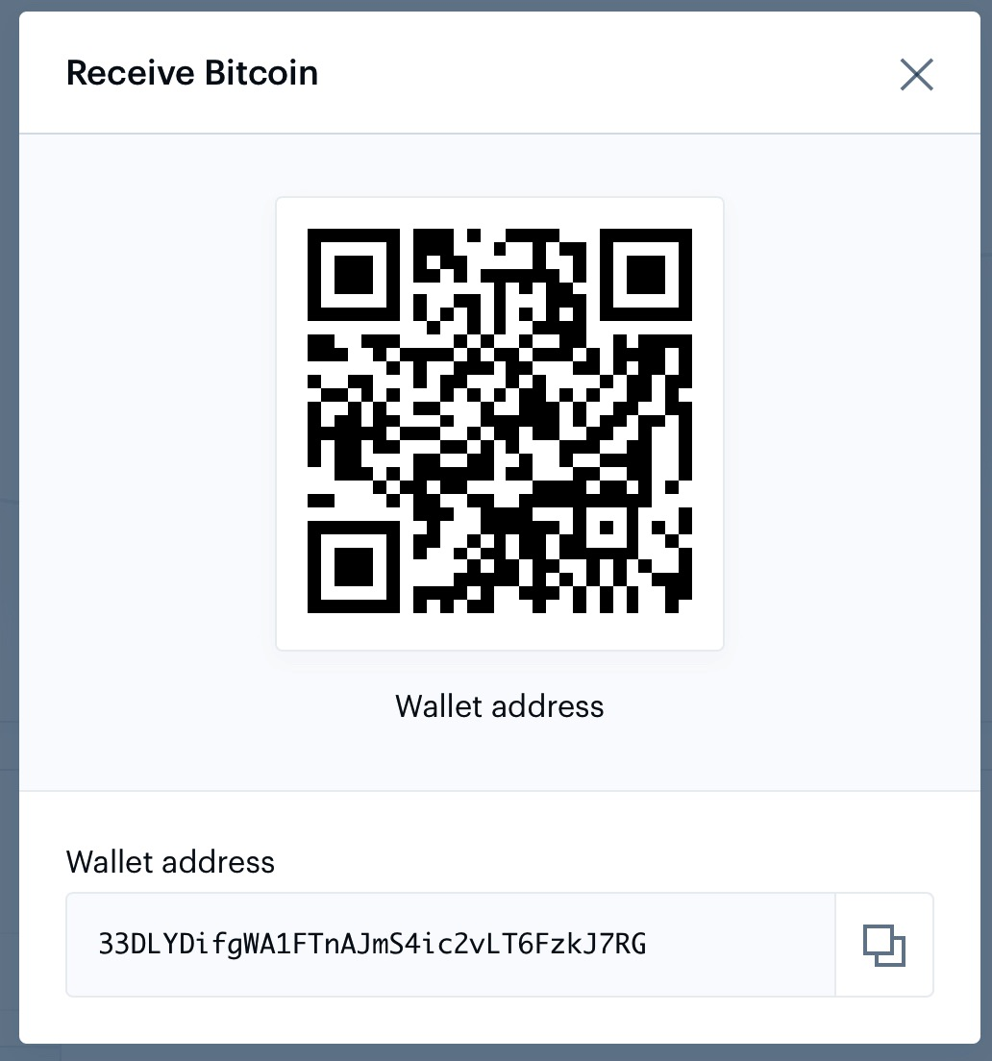
Encoding addresses

Slide 7
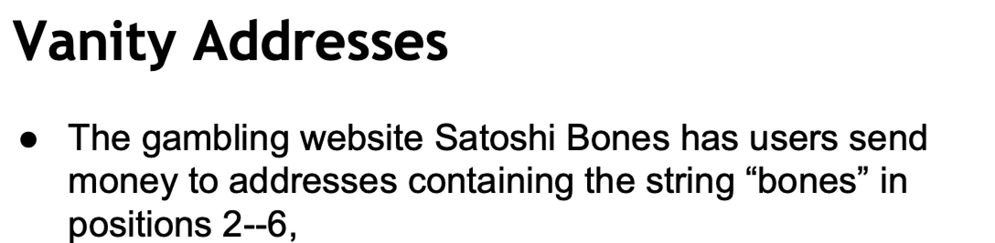

Slide 8
Hot and Cold Storage

Slide 9


Hot storage
Cold storage
online
offline
convenient but risky
archival but safer
separate keys

Slide 10
Problem:
Want to use a new address (and key) for each coin sent to cold
But how can hot wallet learn new addresses if cold wallet is offline?
Awkward solution:
Generate a big batch of addresses/keys, transfer to hot beforehand
Better solution:
Hierarchical wallet

Slide 11
Regular key generation:
address
generateKeys
private key

Slide 12
Hierarchical key generation:
address
gen info
i^{th}
address
genAddr
i
generateKeysHier
i
private key
gen info
i^{th}
key
genKey

Slide 13
hot side
i
address
gen info
i^{th}
address
genAddr
generateKeysHier
private key
gen info
i^{th}
key
genKey
cold side
i

Slide 14
How to store cold info
(1) Info stored in device, device locked in a safe
(2) “Brain wallet” encrypt info under passphrase that user remembers
(3) Paper wallet print info on paper, lock up the paper
(4) In “tamperproof” device, device will sign things for you, but won’t divulge keys
Notes:
Highlight activity of stealing these

Slide 15
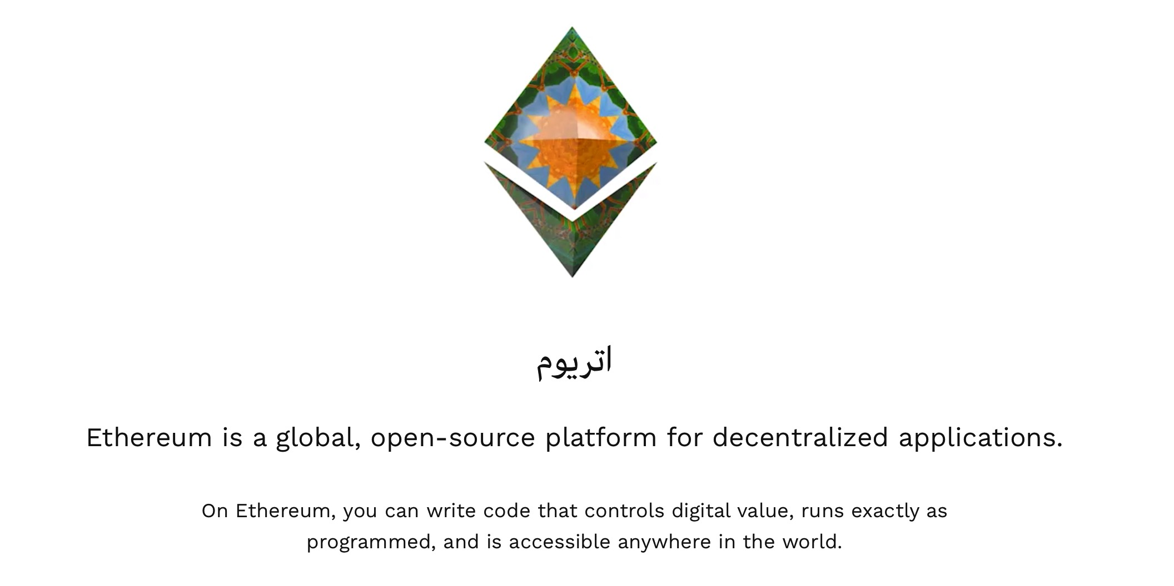

Slide 16
Ethereum: A General-Purpose Blockchain
Ethereum is distributed state machine.
Instead of tracking only the state of currency ownership, Ethereum tracks the state transitions of a general-purpose data store,
a store that can hold any data expressible as a key–value tuple.
A key–value data store holds arbitrary values, each referenced by some key; for example, the value “Mastering Ethereum” referenced by the key “Book Title”.

Slide 17
Compared to Bitcoin
A turing complete language for writing smart contracts
An execution environment (EVM) for executing the contracts.

Slide 18
Accounts in Ethereum
There are two types of accounts in Ethereum.
Externally Owned Accounts (EOAs)
Contract Accounts

Slide 19
EOAs and Contracts
EOAs have a private key; having the private key means control over access to funds or contracts.
A contract account has smart contract code, which a simple EOA can’t have.
A contract account does not have a private key.
It is owned (and controlled) by the logic of its smart contract code

Slide 20
Contracts
Contracts have addresses, just like EOAs. Contracts can also send and receive ether, just like EOAs.
When a transaction destination is a contract address, it causes that contract to run in the EVM, using the transaction, and the transaction’s data, as its input.
In this way, transactions can call functions within contracts.

Slide 21
Contracts
Only EOAs can initiate transactions, but contracts can react to transactions by calling other contracts, building complex execution paths.

Slide 22
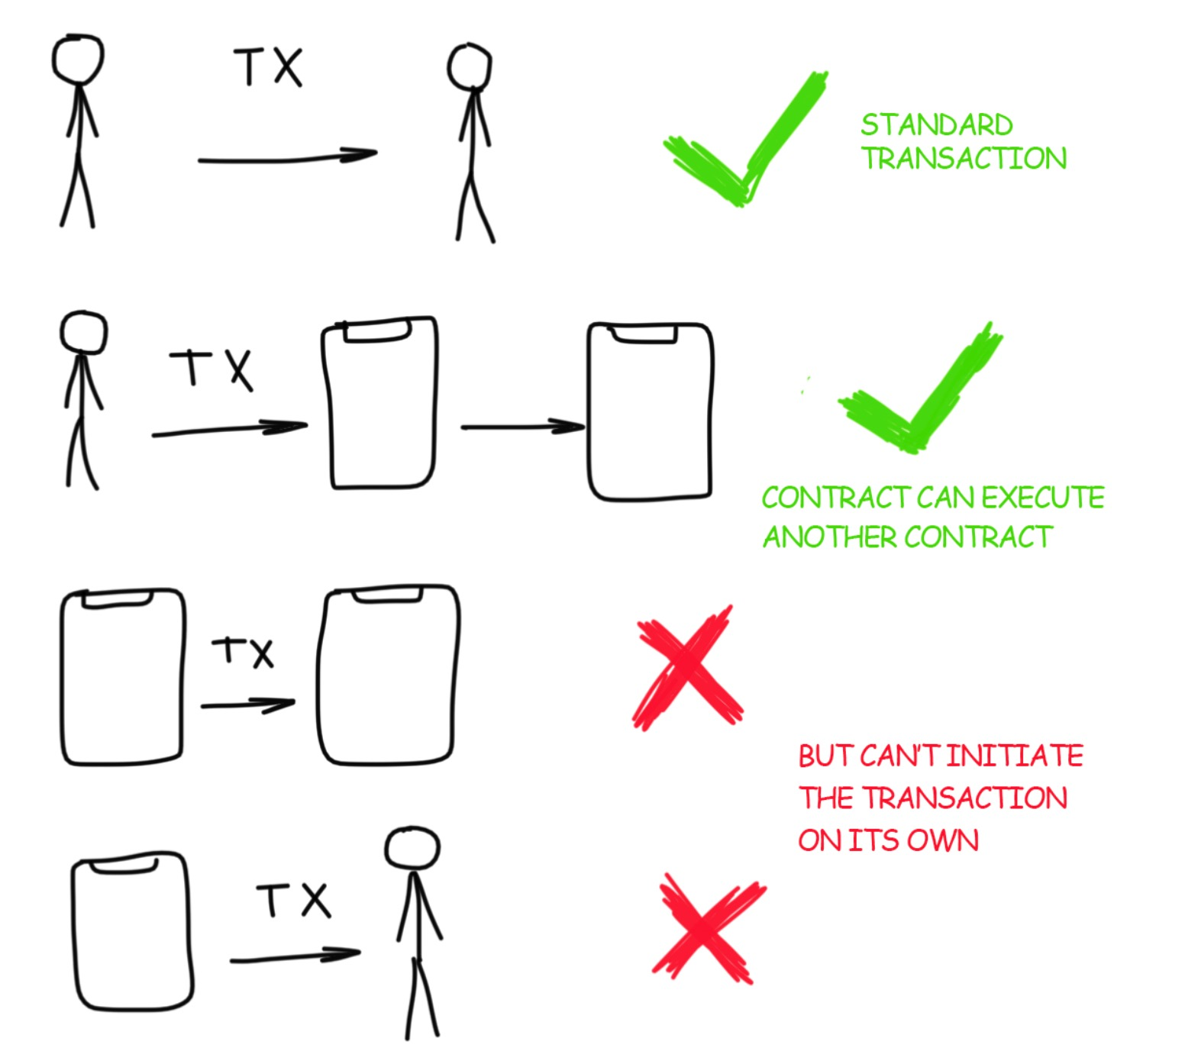

Slide 23
A Simple Contract: A Test Ether Faucet
Ethereum has many different high-level languages, all of which can be used to write a contract and produce EVM bytecode.
One high-level language is by far the dominant choice for smart contract programming: Solidity.

Slide 24
A Simple Contract: A Test Ether Faucet
For our first example, we will write a contract that controls a faucet.
A faucet is a relatively simple thing: it gives out ether to any address that asks, and can be refilled periodically.

Slide 25
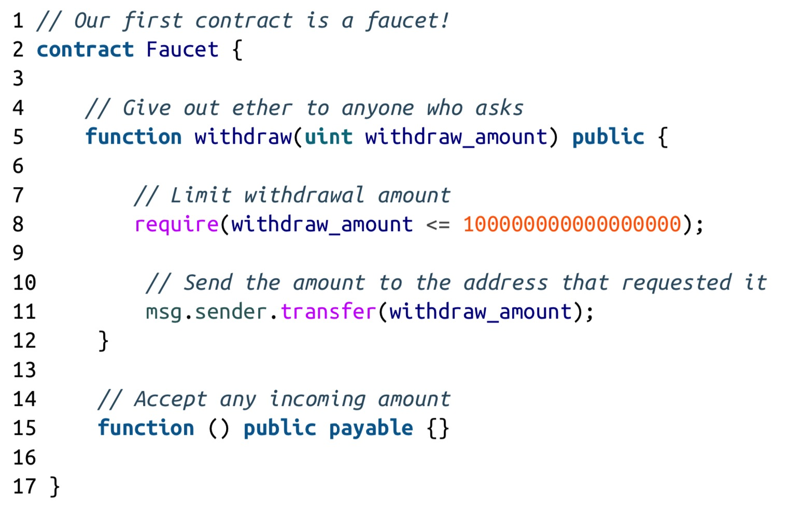
A Simple Contract: A Test Ether Faucet

Slide 26
An even simpler contract
pragma solidity >=0.4.0 <0.7.0;
contract SimpleStorage {
uint storedData;
function set(uint x) public {
storedData = x;
}
function get() public view returns (uint) {
return storedData;
}
}

Slide 27
Compile/Deploy/Interact?
We know how to do this? Once deployed, we will have a contract address and we can make transactions.
Lets consider an updated version of contract.
How to change contract code once deployed?
function set(uint x) public {
storedData = x+1;
}

Slide 28
Modifying Contracts?
Contracts are immutable so is our blockhain.
Contracts cannot be changed, we need to deply a new one*.
A development environment can help us manage different processes!
*some workarounds are possible in practice

Slide 29
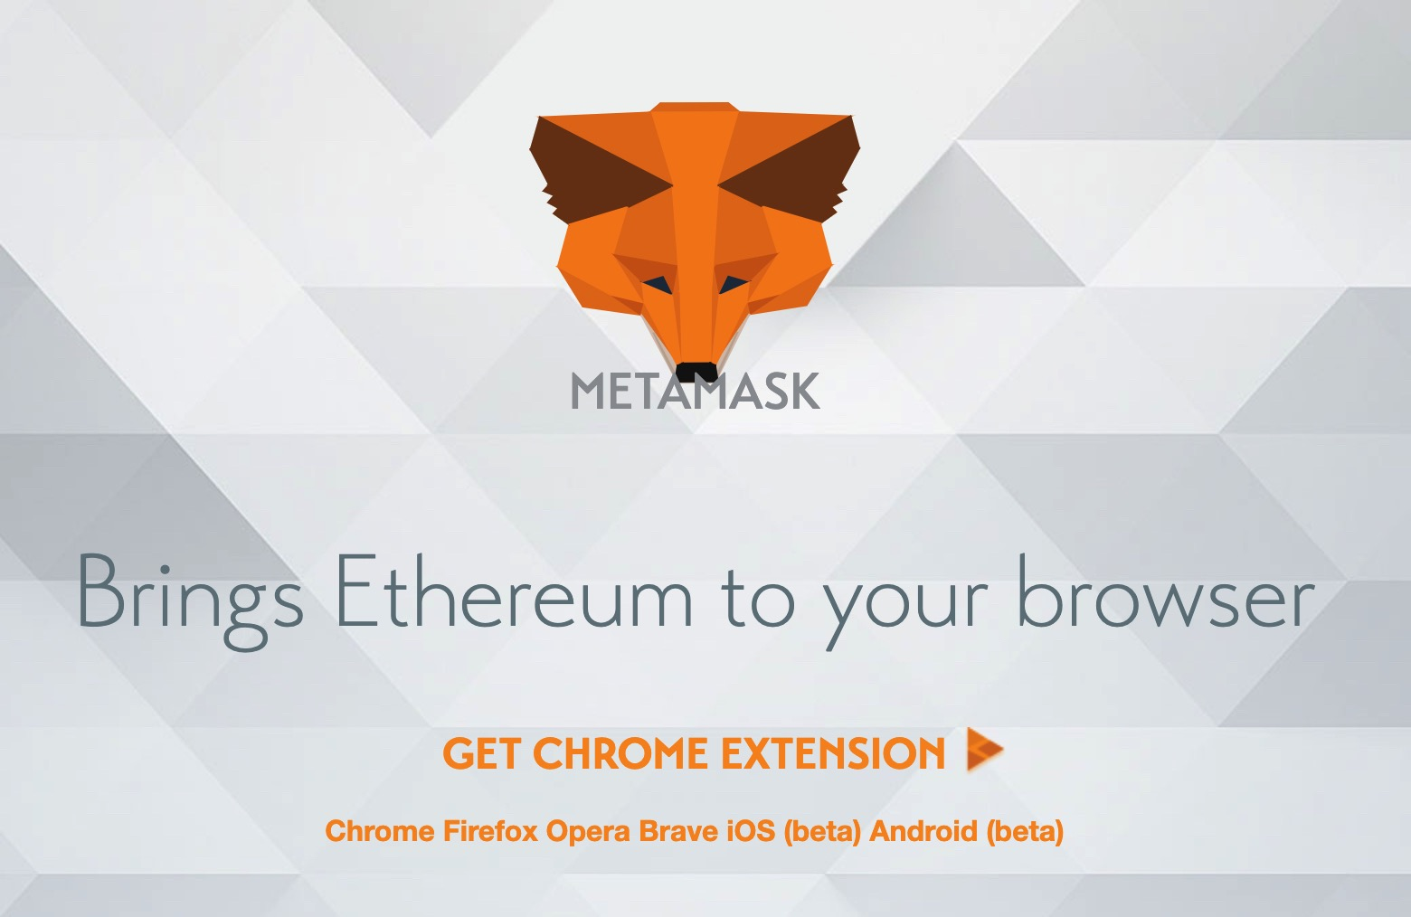
Ethereum Wallet
Meta Mask - https://metamask.io/
"MetaMask is a bridge that allows you to run Ethereum dApps right in your browser without running a full Ethereum node."

Slide 30
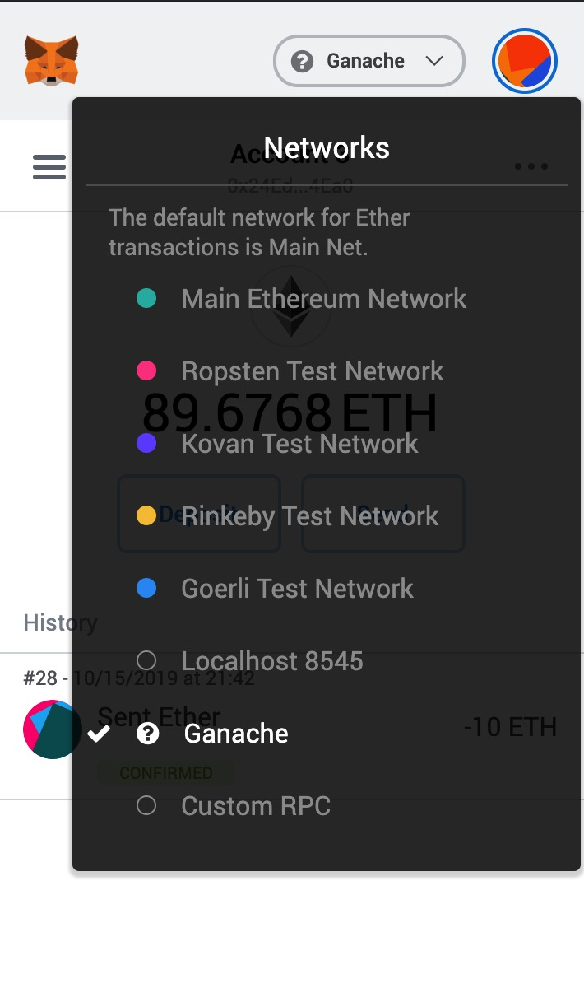
Ethereum Wallet
Once installed as a browser extension, it allows to connect to multipile etherum networks

Slide 31
Ethereum Wallet
Once installed as a browser extension, it allows to connect to multipile etherum networks
Main Ethereum Network - The main public Ethereum blockchain. Real ETH, real value, and real conse‐ quences.
Ropsten Test Network - Ethereum public test blockchain and network. ETH on this network has no value.

Slide 32
Getting Ethers on Ropsten
Use the Faucet at https://ropsten.etherscan.io, https://faucet.metamask.io/
Transaction and block history available at, https://ropsten.etherscan.io

Slide 33
Local blockchain
How about a local pre-loaded ethereum chain with addresses, ethers and ability to view blocks, transactions ...
Fortunately, Ganache provides exactly that.

Slide 34
Ganache
Ganache is a personal blockchain for Ethereum development you can use to deploy contracts, develop your applications, and run tests.
It is available as both a desktop application as well as a command-line tool for Windows, Mac, and Linux.

Slide 35
1. Install Ganache
Download the appropriate version for your OS from https://www.trufflesuite.com/ganache
Scrolll below to find the appropriate binary, double-click to install easily.

Slide 36
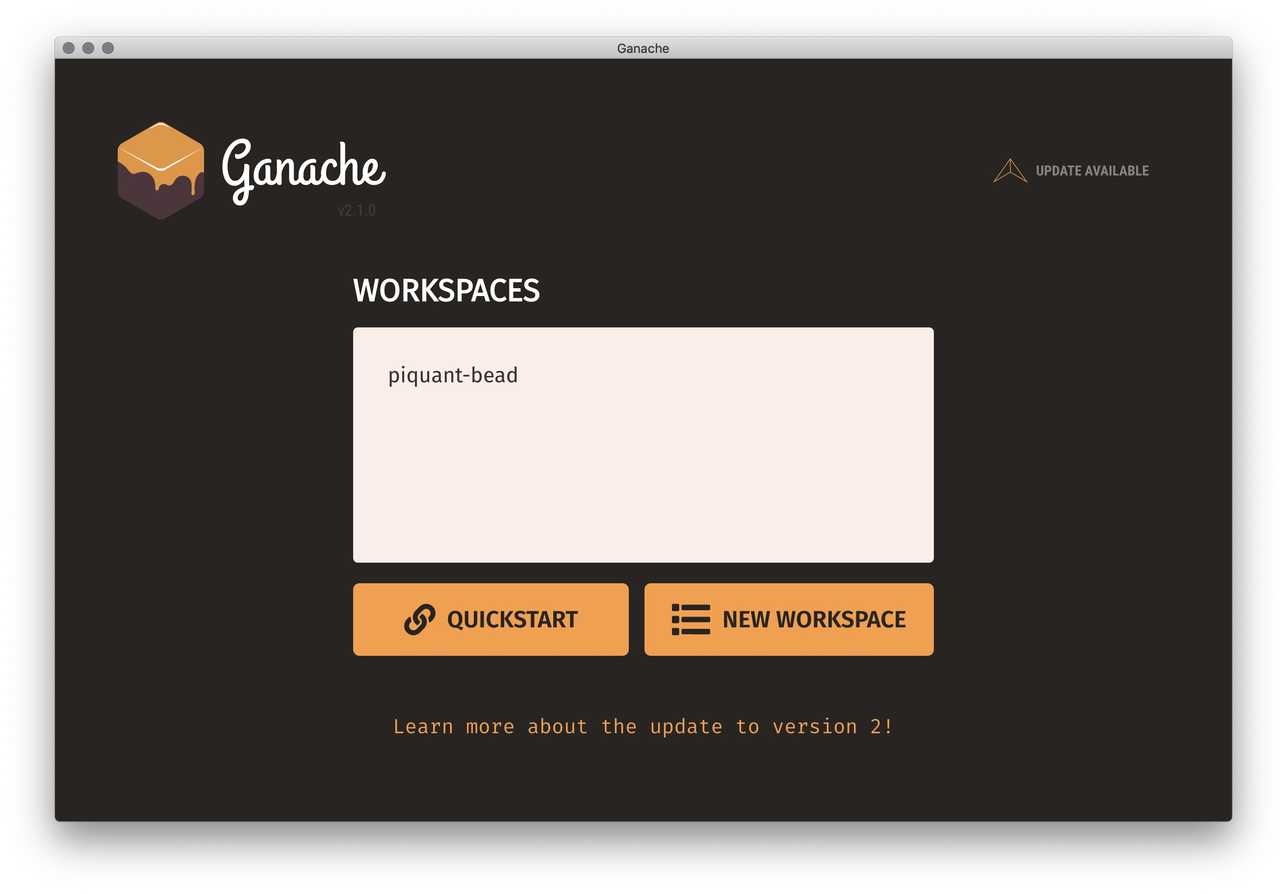
2. Create a Workspace

Slide 37
Fun Stuff – Linking MetaMask to Ganache
We know that we can switch between multiple ethereum network on MetaMask
Ganache was manually added in the list

Slide 38
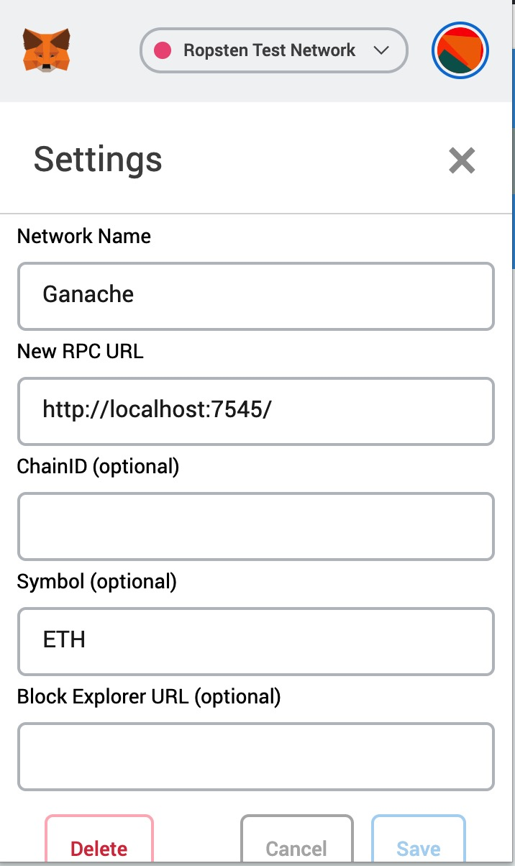
Fun Stuff – Linking MetaMask to Ganache
The GUI version of Ganache listens at port 7545 (CLI version probably at 8545).
We can however use CustomRPC option of MetaMask to add networks

Slide 39
Fun Stuff – Linking MetaMask to Ganache
We can now add Ganache accounts and transfer ethers amongst them
It will also help us understanding how import/export of accounts work.

Slide 40
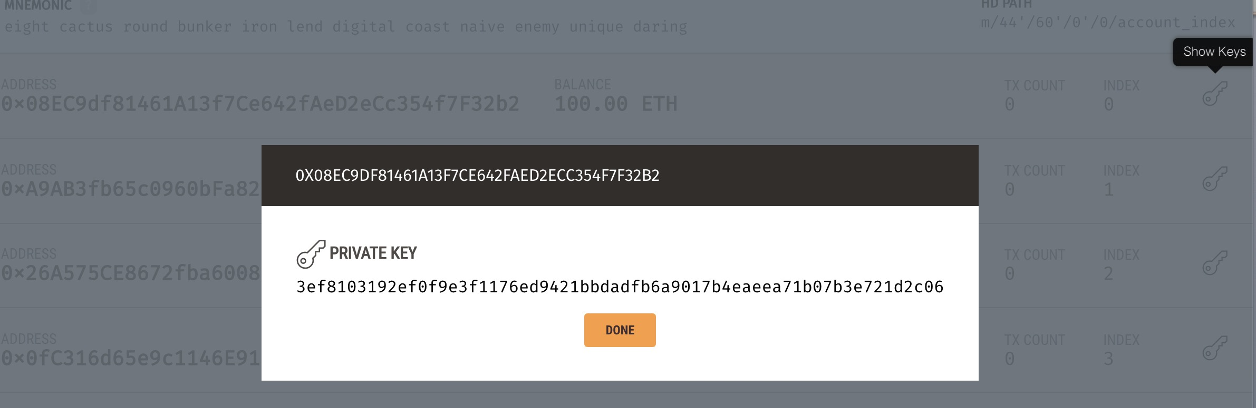
Fun Stuff – Linking MetaMask to Ganache
On the Ganache main page, click on the key icon towards the right

Slide 41
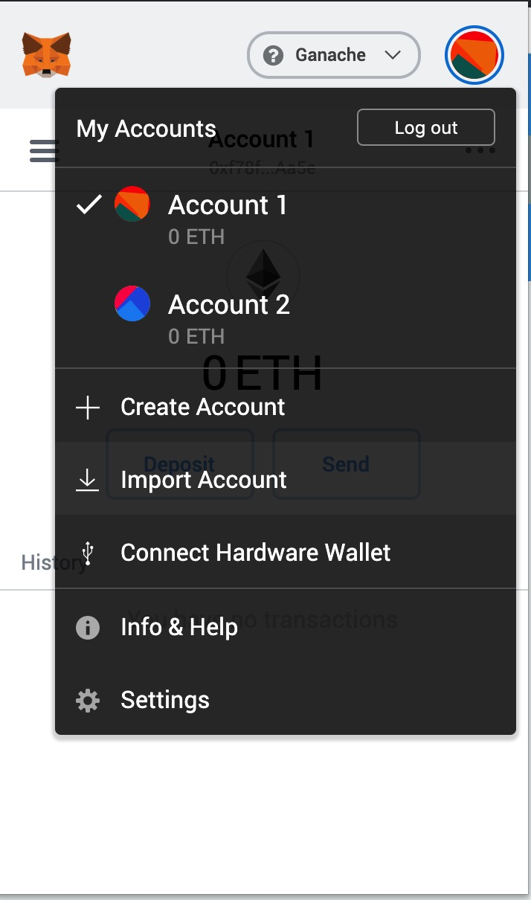
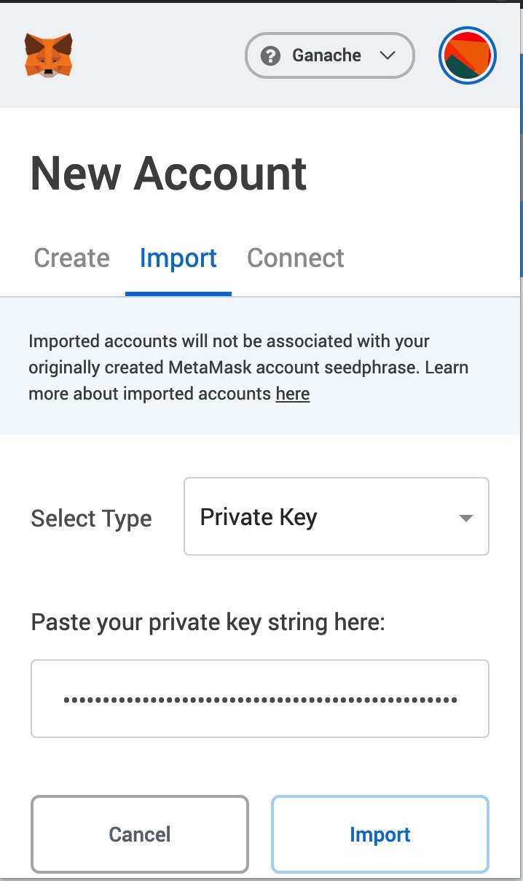
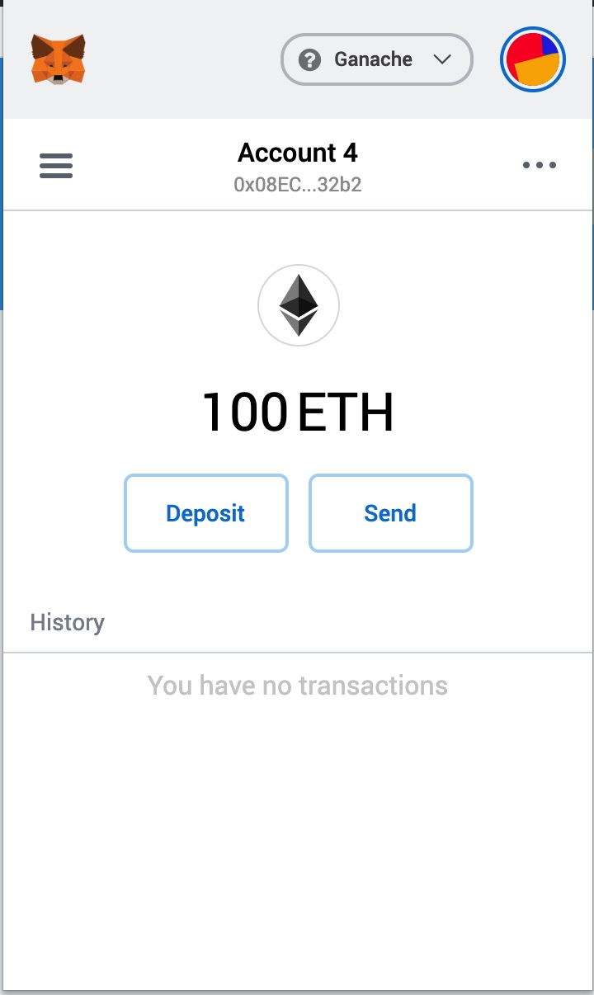
Fun Stuff – Linking MetaMask to Ganache

Slide 42
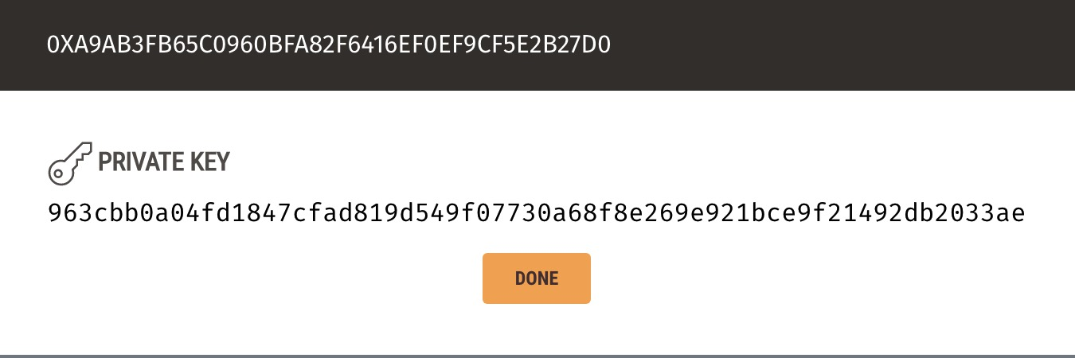
Fun Stuff – Linking MetaMask to Ganache
We can now use this account to make a transaction.
Lets send some ethers to another account ,the second one at Ganche main page .
To send we need address, we can copy from Ganche.

Slide 43
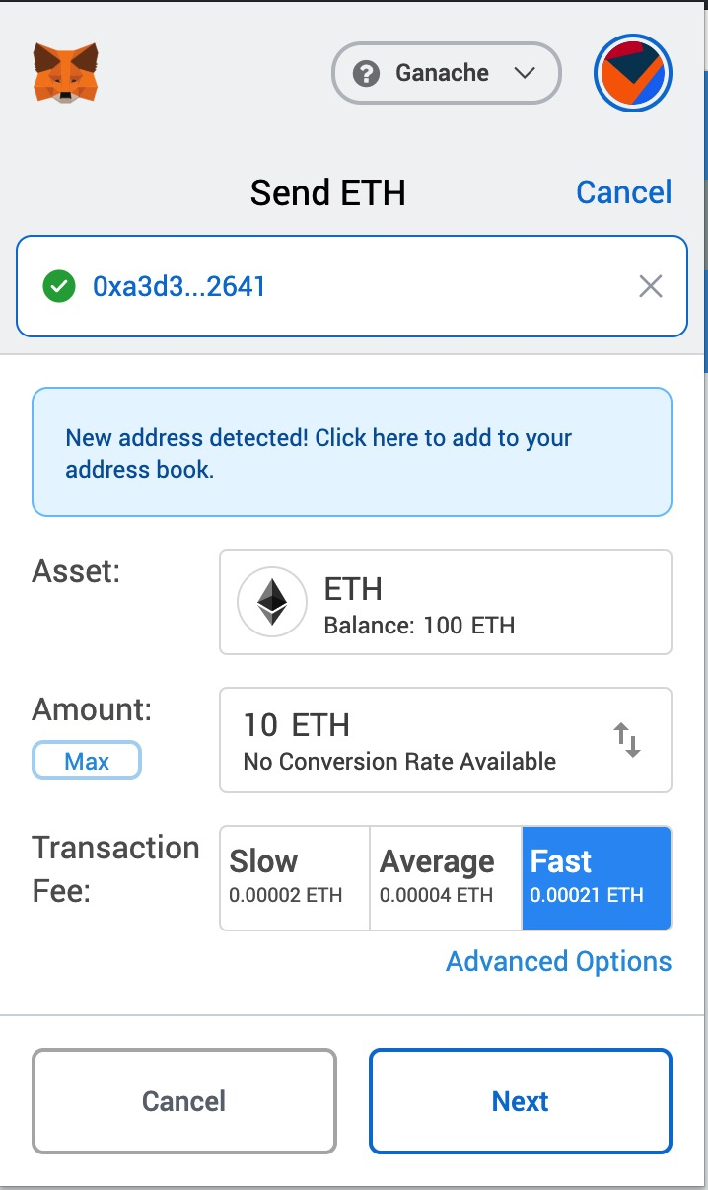
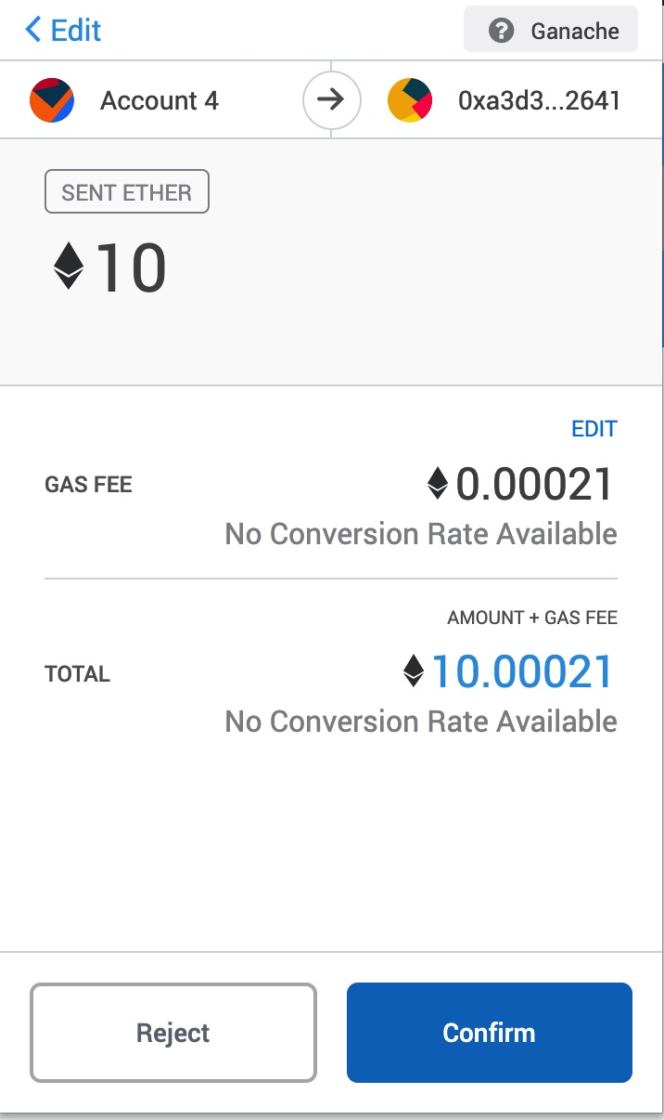
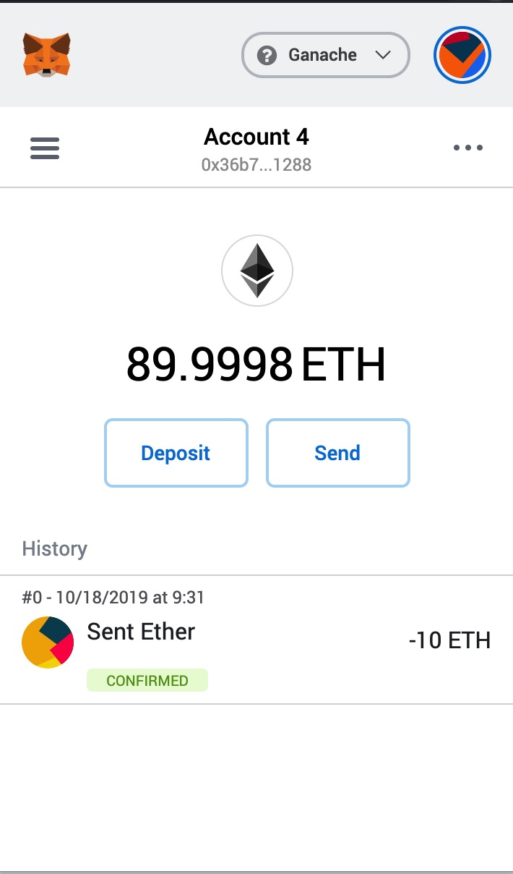
Fun Stuff – Linking MetaMask to Ganache
We know how to send a transaction using MetaMask?

Slide 44
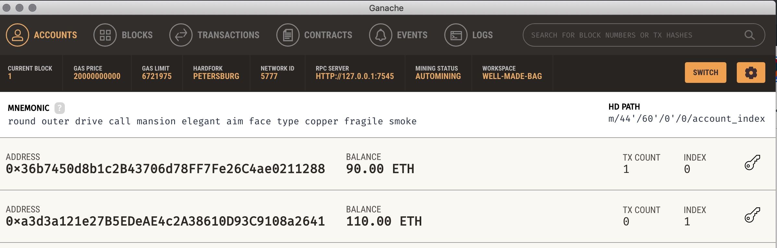
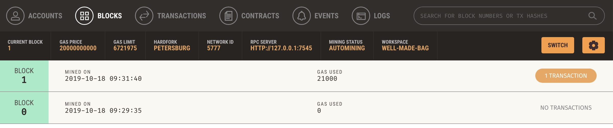
Fun Stuff – Linking MetaMask to Ganache

Slide 45
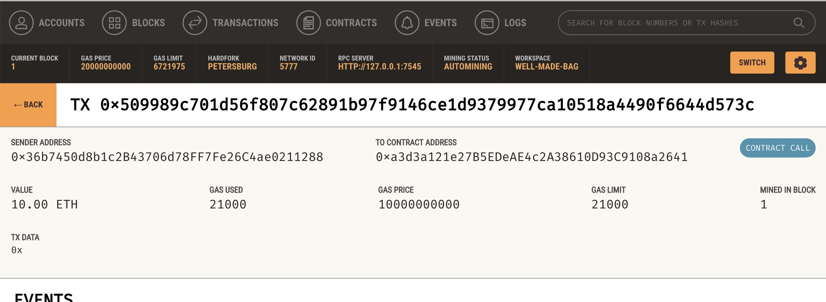
Fun Stuff – Linking MetaMask to Ganache

Slide 46
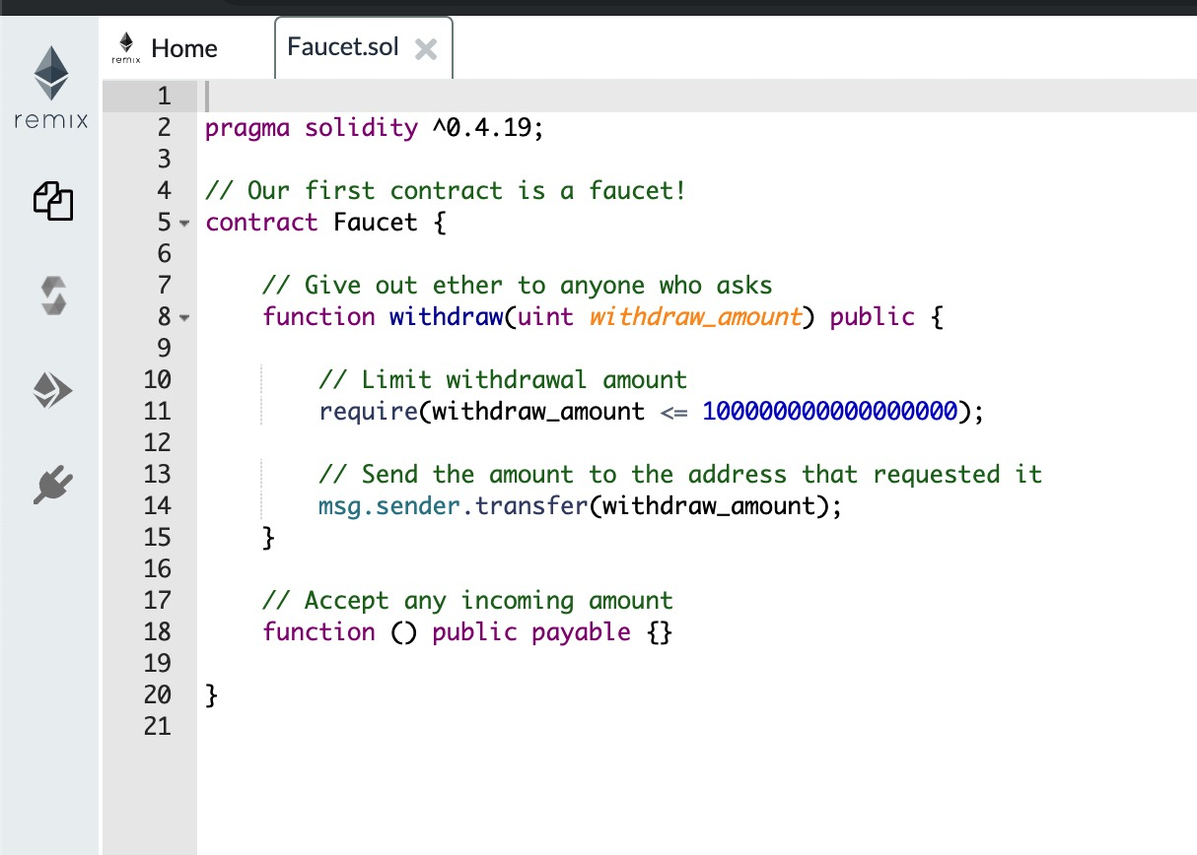
Ethereum IDEs
Remix – Web based IDE http://remix.ethereum.org/

Slide 47
Ethereum IDE
Remix allows to compile, deploy and invoke smart contracts.
Smart contracts are immutable, it is less efficient to do things manually

Slide 48
Let’s have more FUN
As we change MetaMask network, Remix IDE page refreshes
What does it mean?

Slide 49
Remix IDE and Ganache
Through MetaMask Remix IDE connects with our local Ganache chain.
This means that we can deploy our faucet contract on the Ganache?
Let’s try that.

Slide 50
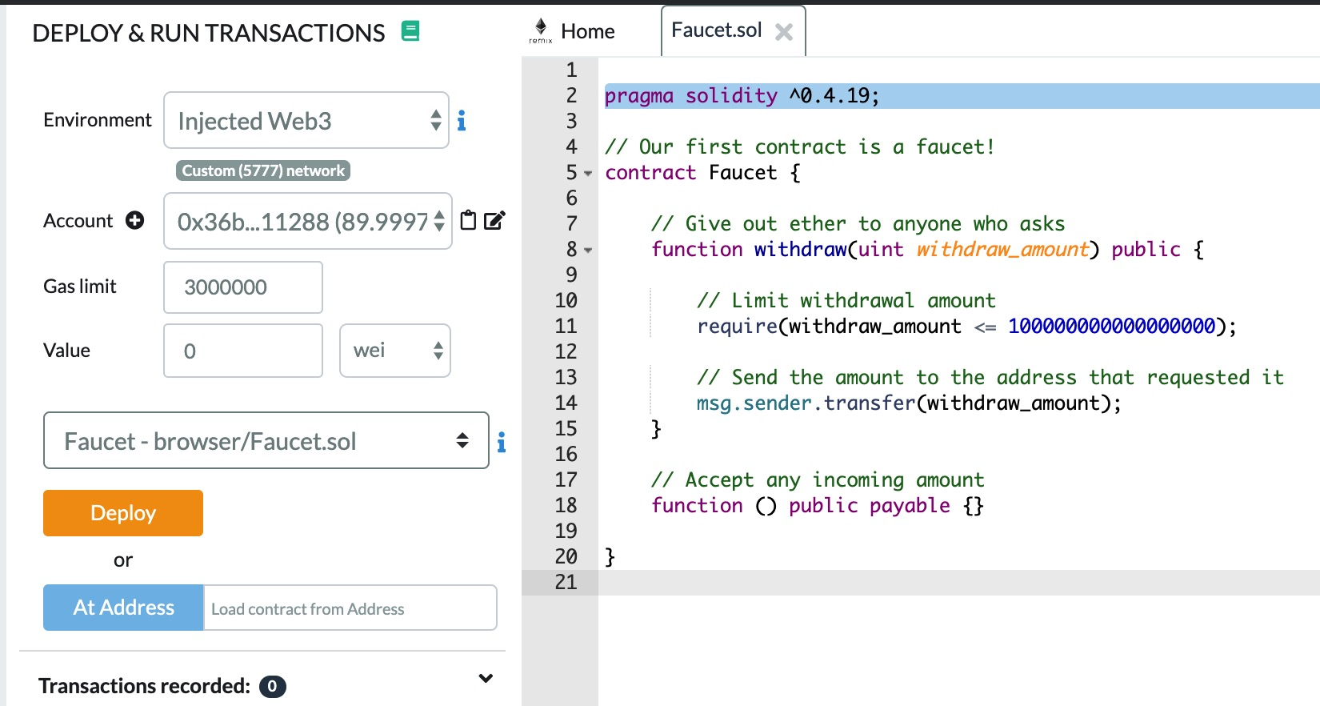
Remix IDE and Ganache

Slide 51
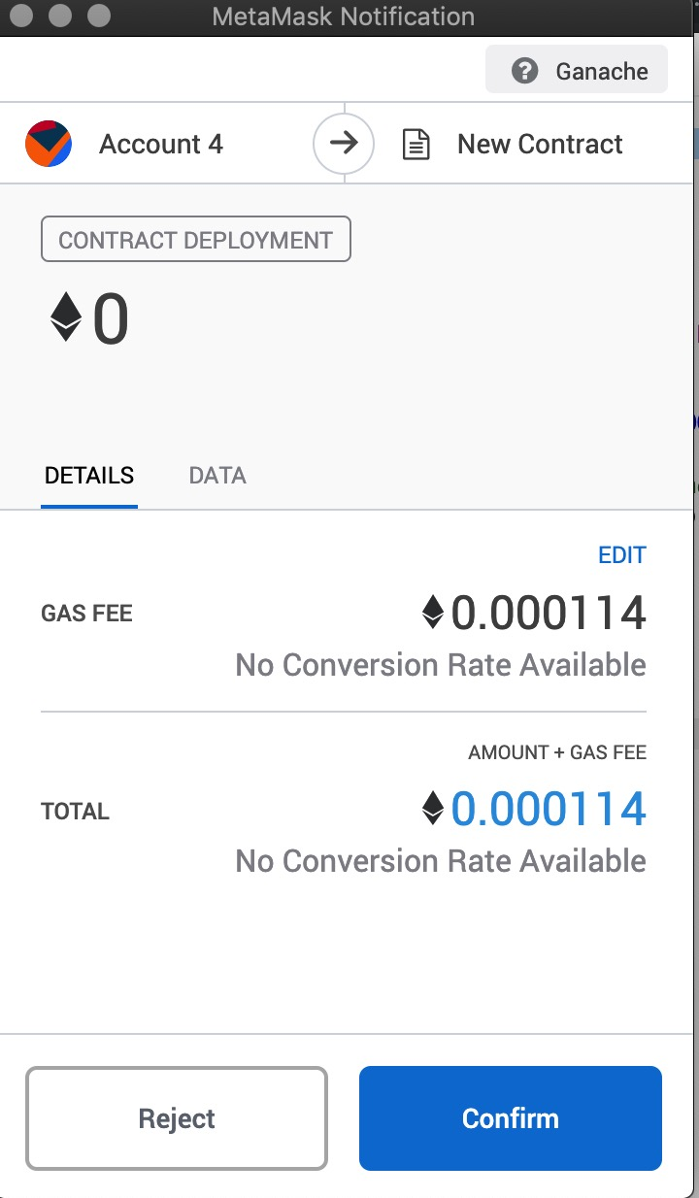
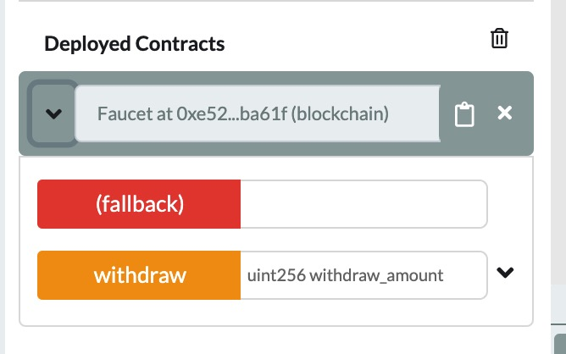
Remix IDE and Ganache

Slide 52
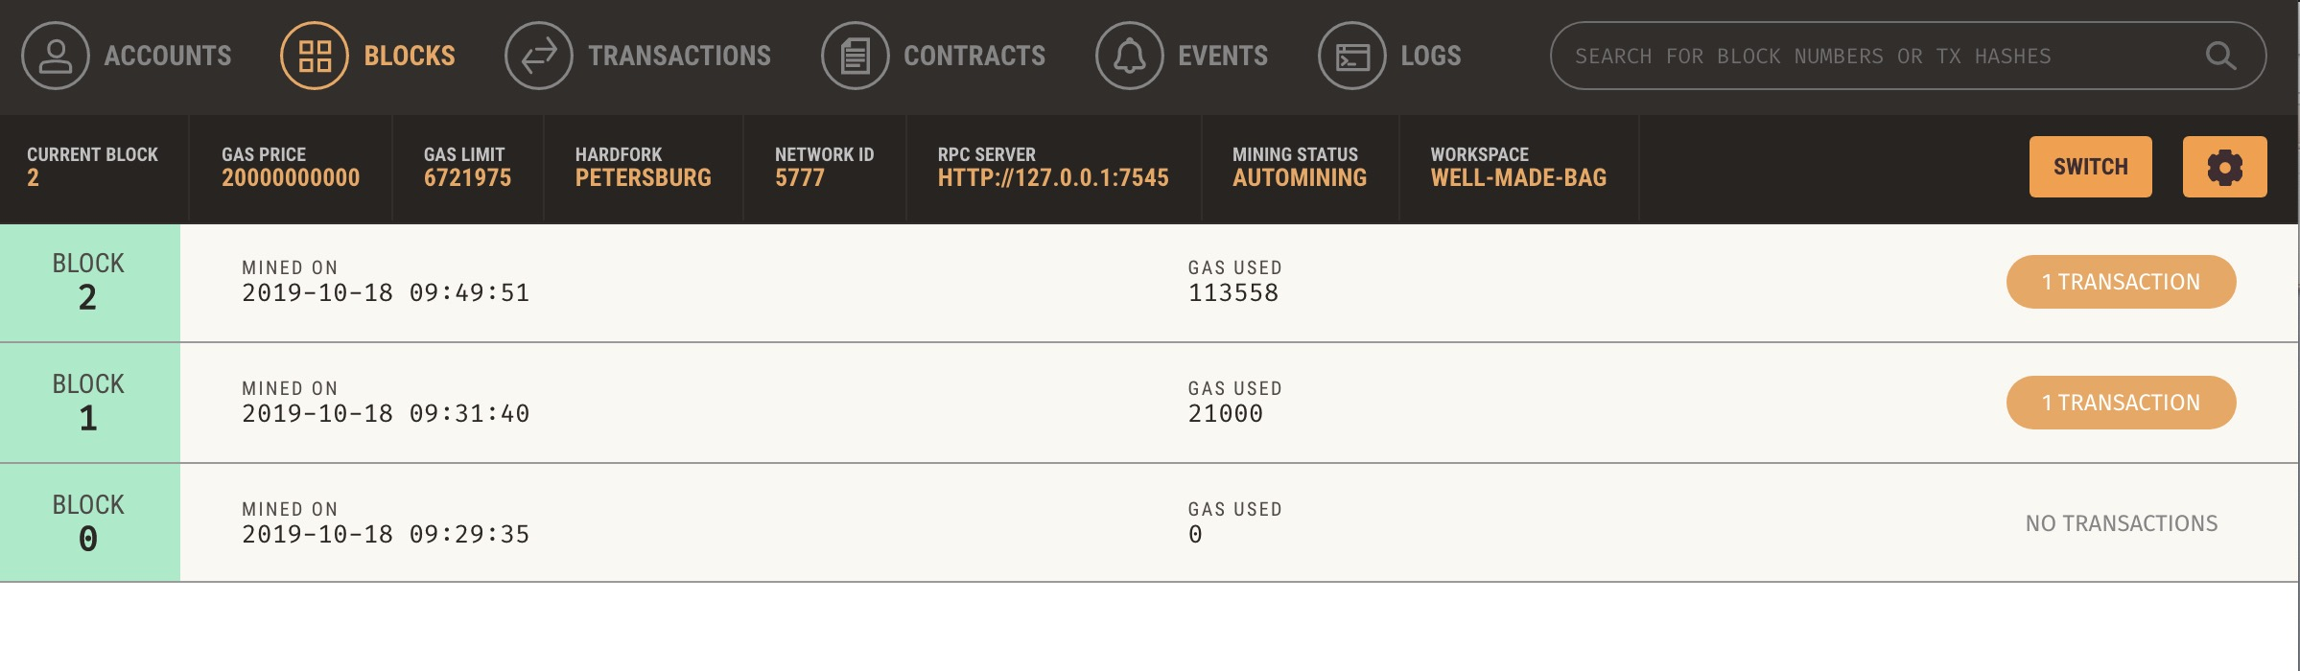
Contract at Ganache
First look, there is a new block

Slide 53
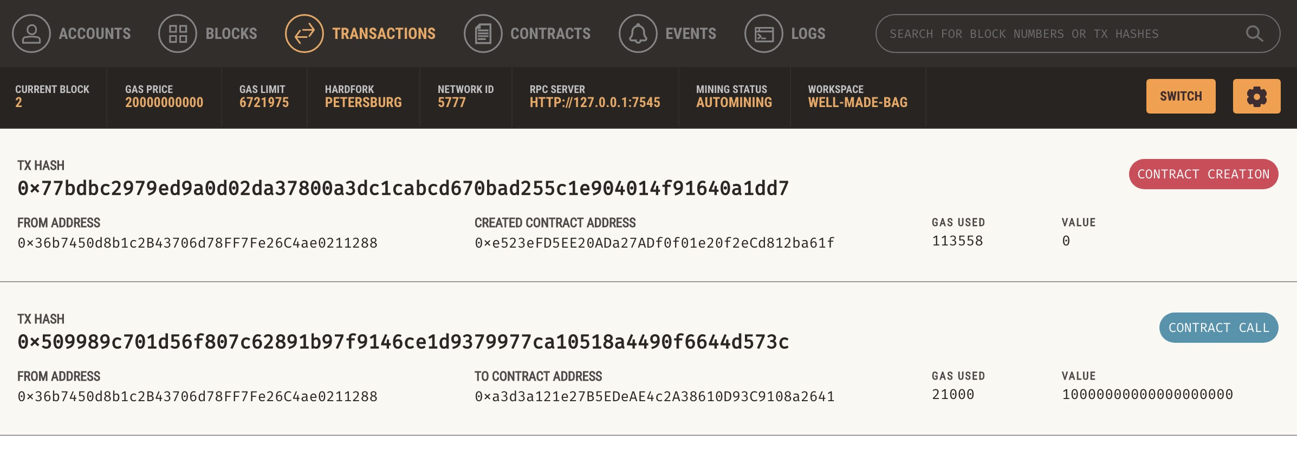
Contract at Ganache
What does the new block contain?

Slide 54
Interacting with the Contract
Lets give our faucet some ethers.
How it can be done?
Our contract has an address? If yes we can just send some ethers to that address.

Slide 55
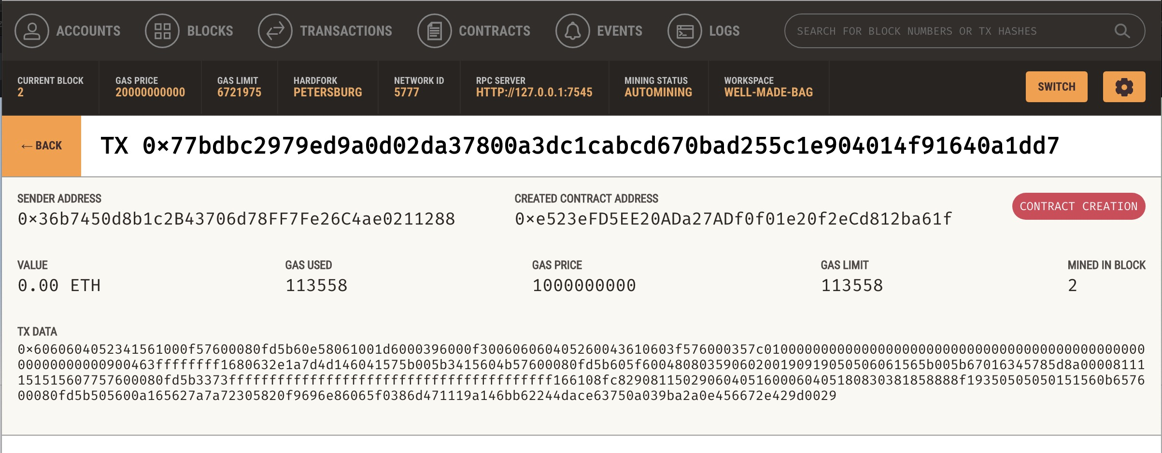
Contract Address

Slide 56
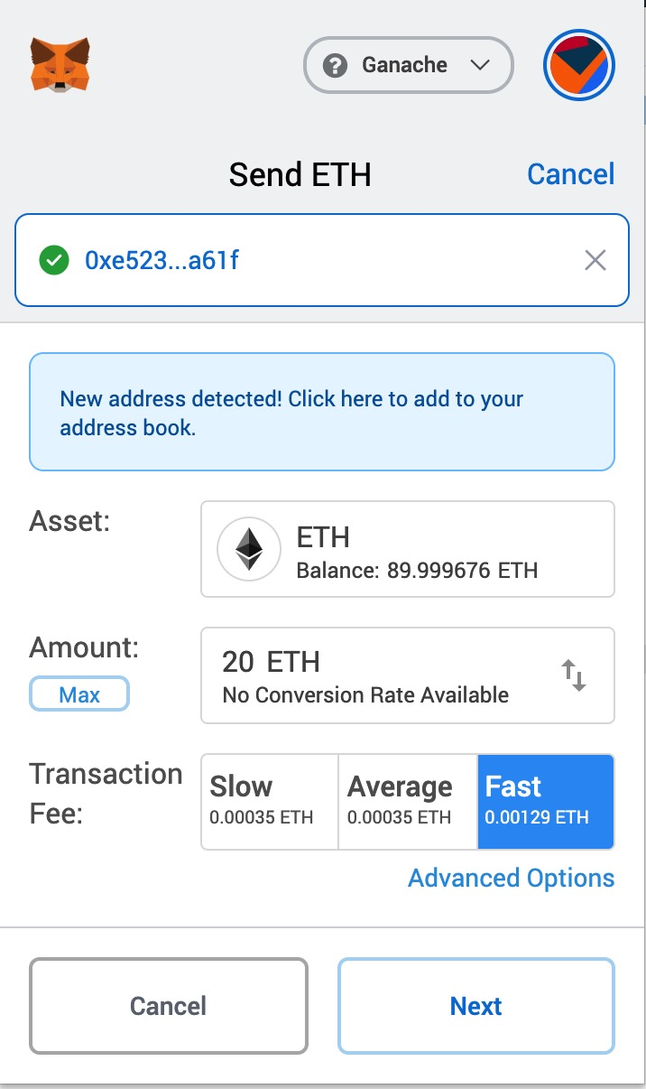
Ethers to Faucet

Slide 57
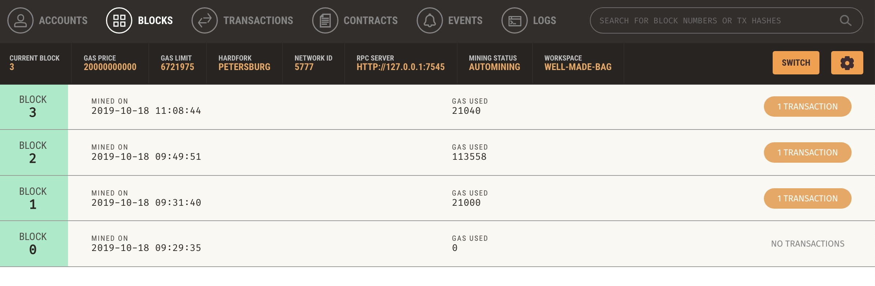
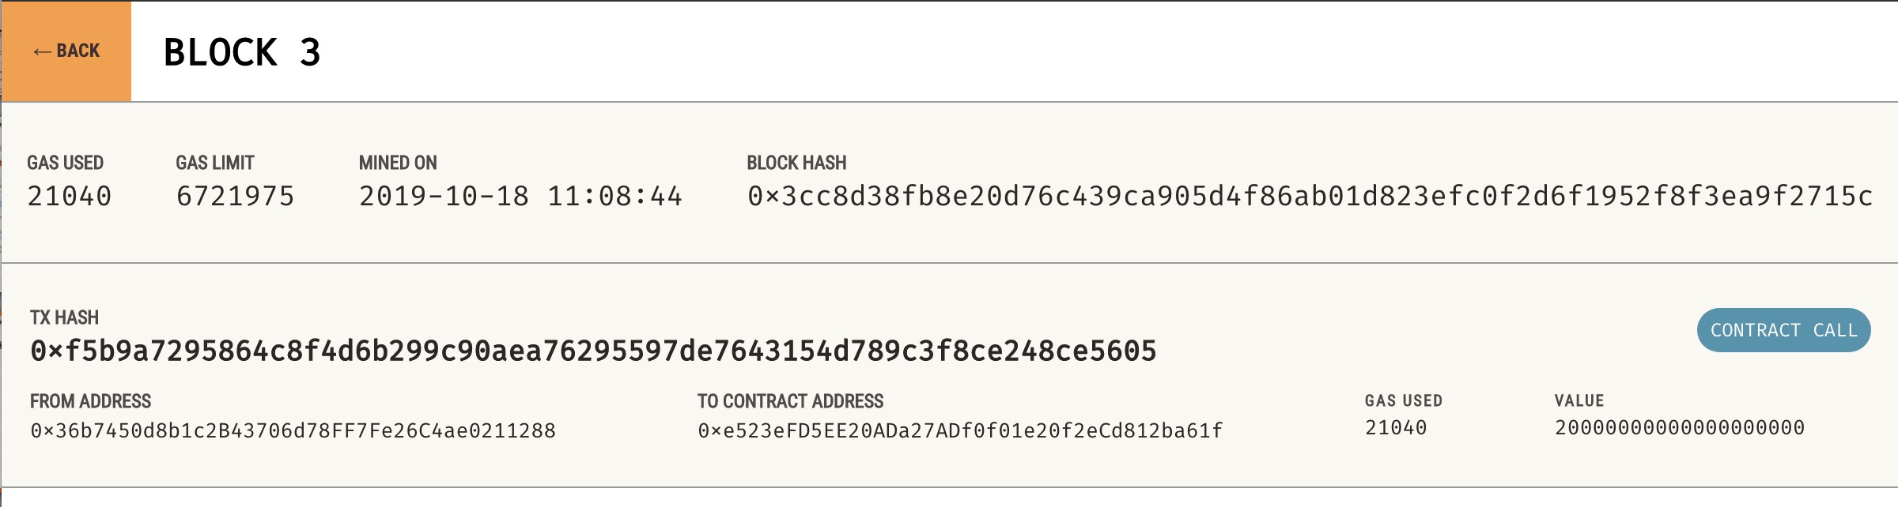
...back at Ganache

Slide 58
So far so good ...
How can we withdraw ethers from the faucet?
For the time being use remix to create a withdraw transaction.
How much we can withdraw?
// Limit withdrawal amount
require(withdraw_amount <= 100000000000000000);

Slide 59
Contract deployment
It quickly becomes tedious and limiting to do things all over again.
A tool, development environment to automate stuff would make life much easier.

Slide 60
Truffle
"Sweet Tool for the Smart Contracts"
A development environment for blockchains using the Ethereum Virtual Machine (EVM), aiming to make life as a developer easier.
npm install truffle -g

Slide 61
npm
npm is a package manager for the JavaScript programming language.
It is the default package manager for the JavaScript runtime environment Node.js.
It consists of a command line client, also called npm, and an online database of packages, called the npm registry.

Slide 62
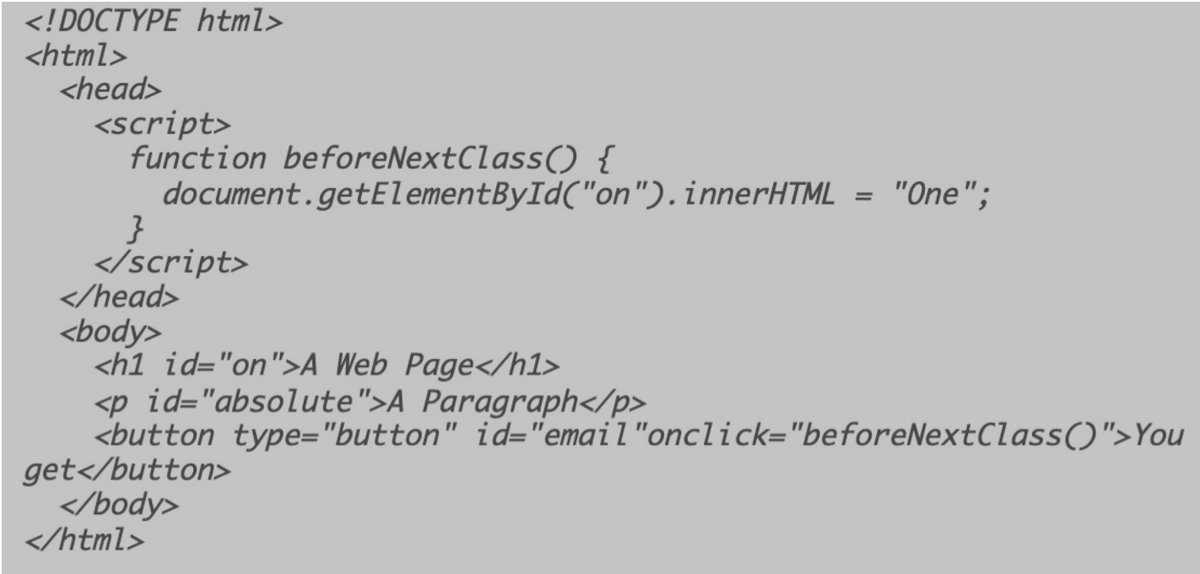
Javascript

Slide 63
Javascript
We can place the script in the HTML Head of Body. Placement at the end of body improves performance.
We can put in all our code in an external .js file
<script src="myScript.js"></script>

Slide 64
Javascript
<script>
var person = {
firstName: "John",
lastName : "Doe",
id : 5566,
fullName : function() {
return this.firstName + " " + this.lastName;
}
};
alert(person.fullName())
</script>

Slide 65
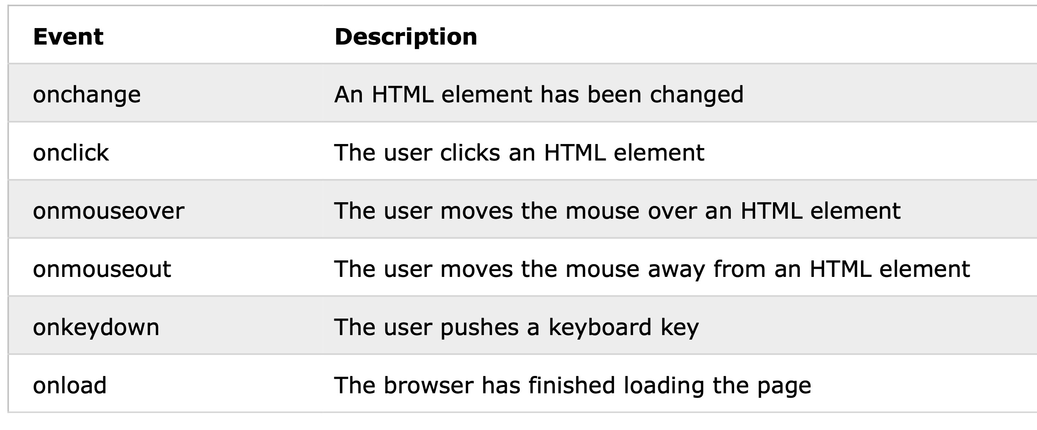
Common HTML Events

Slide 66
JSON (JavaScript Object Notation)

Slide 67
JSON (JavaScript Object Notation)
JSON is a light-weight alternative to XML for data-interchange
See http://json.org/ for the detailed syntax of JSON.

Slide 68
JSON is built on two structures
A collection of name/value pairs.
In various languages, this is realized as an object, record, struct, dictionary, hash table, keyed list, or associative array.
e.g.: An object with three properties named "a", "b", and "c"
{ "a":1,"b":2,"c":3 }
An ordered list of values.
In most languages, this is realized as an array, vector, list, or sequence.
e.g.: An array of three integers and one string value
[ 1, 2, 3, "value #4 with" ]

Slide 69
Example
{"firstName": "John",
"lastName" : "Smith",
"age" : 25,
"address" :
{"streetAdr” : "21 2nd Street",
"city" : "New York",
"state" : "NY",
”zip" : "10021"},
"phoneNumber":
[{"type" : "home",
"number": "212 555-1234"},
{"type" : "fax",
"number” : "646 555-4567"}]
}
This is a JSON object with five key-value pairs
Objects are wrapped by curly braces
There are no object IDs
Keys are strings
Values are numbers, strings, objects or arrays
Ararys are wrapped by square brackets

Slide 70
Server-side JavaScript - Node.js
JavaScript is a “complete” language: you can use it in many contexts and achieve everything with it you can achieve with any other “complete” language.
Node.js really is just another context: it allows you to run JavaScript code in the backend, outside a browser.

Slide 71
Server-side JavaScript - Node.js
Plus, Node.js ships with a lot of useful modules, so you don’t have to write everything from scratch,
Thus, Node.js is really two things: a runtime environment and a library.

Slide 72
A Webserver
var http = require("http");
function sendResponse(request, response)
{
response.writeHead(200, {"Content-Type": "text/plain"});
response.write("Hello World");
response.end();
}
http.createServer(sendResponse).listen(8888);

Slide 73
npm – Node Package Manager
npm install upper-case
//hello-world.js
upper = require("upper-case")
console.log(upper("Hello World"));

Slide 74
back to Truffle ...
Sweet Tool for the Smart Contracts
A development environment for blockchains using the Ethereum Virtual Machine (EVM), aiming to make life as a developer easier.
npm install truffle -g

Slide 75
The Truffle workflow
You can create a bare project template or you can use Truffle Boxes, which are example applications and project templates.
We wont use the boxes, however the MetaCoin box is a good start

Slide 76
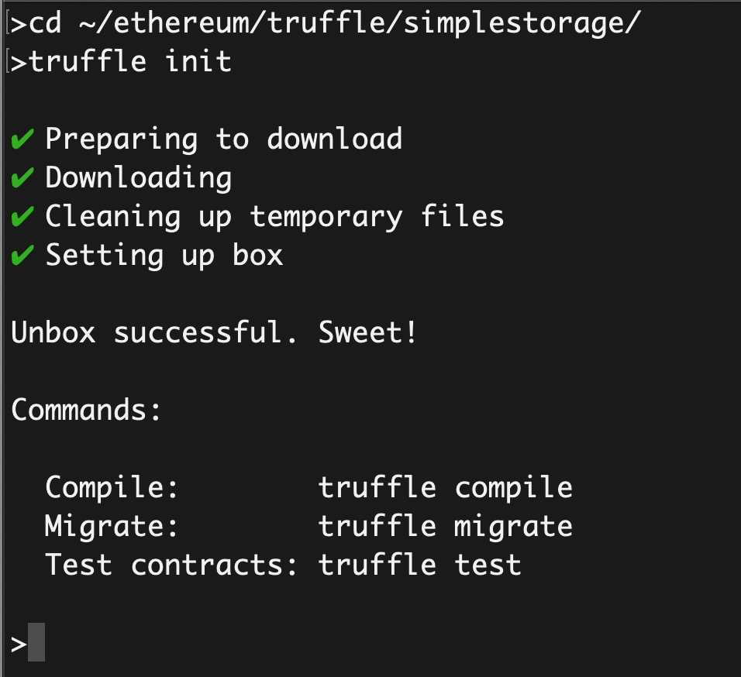
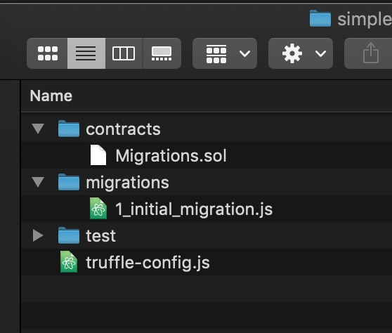
The Truffle workflow – New Project
Create a directory somewhere to store our truffle project.
In my case, the path is ~/ethereum/truffle/simplestorage

Slide 77
The Truffle workflow – New Project
Truffle has created a directory structure for us
The contracts subfolder will host all our contracts, and once compiled the output is stored in build folder. There is already a contract there named migrations.sol.
The migrations folder will contain migration scripts used by truffle to manage deployments.

Slide 78
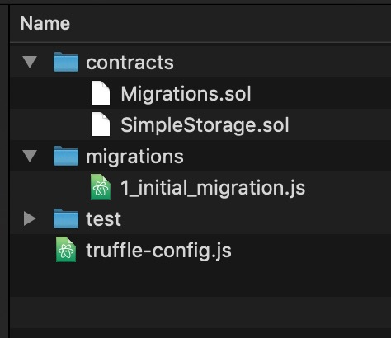
The Truffle workflow – SimpleStorage
For our SimpleStorage contract, lets place the source under the contracts folder, our file is named SimpleStorage.sol

Slide 79
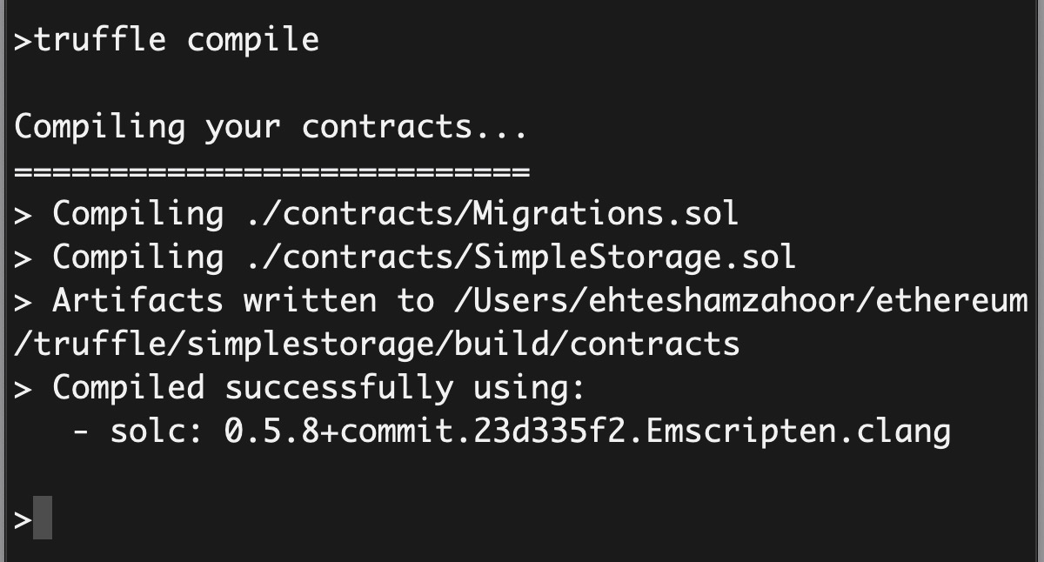
The Truffle workflow – SimpleStorage
To compile our contract, we can use truffle compile. You will notice the build folder in the directory structure.

Slide 80
The Truffle workflow – SimpleStorage
To migrate our contract to the network (Ganache by default but others can be configured), we can use truffle migrate.
To better explore the processes, create a new workspace in Ganache. We are at block 0.

Slide 81
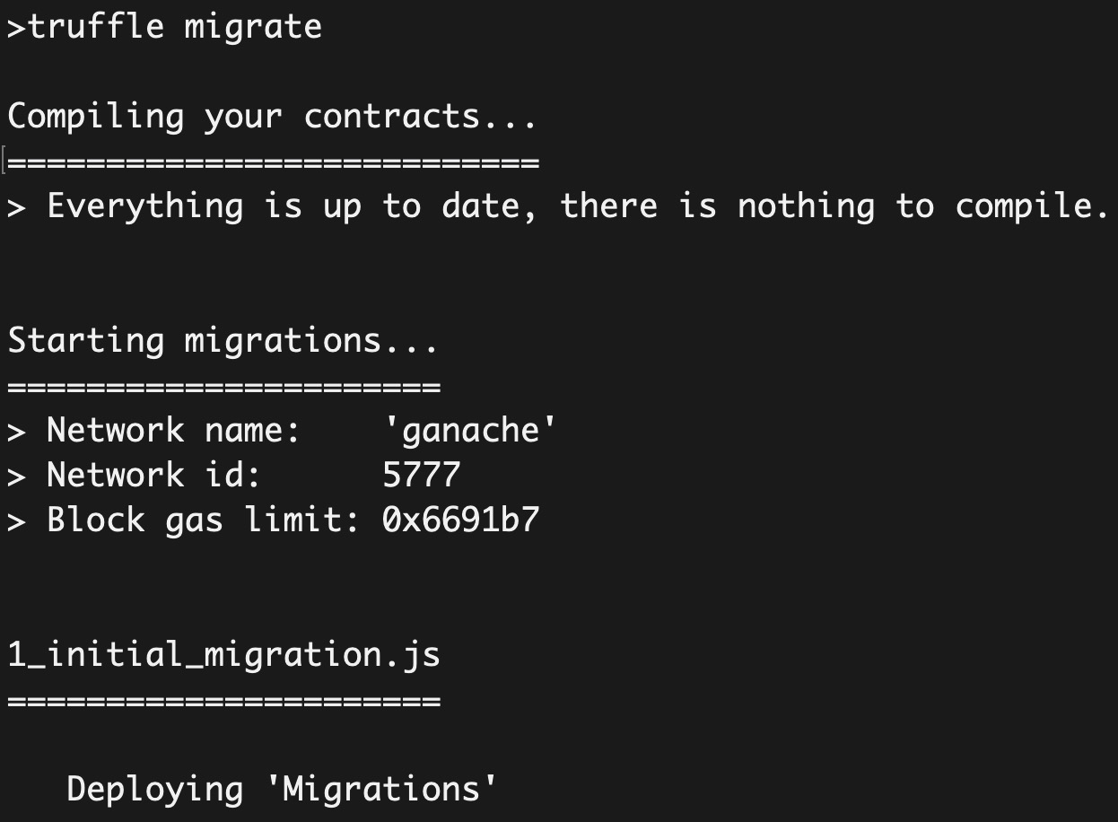
The Truffle workflow – SimpleStorage
To migrate our contract, we can use truffle migrate. Unfortunately, it didnt migrate our contract but rather the migration contract.

Slide 82
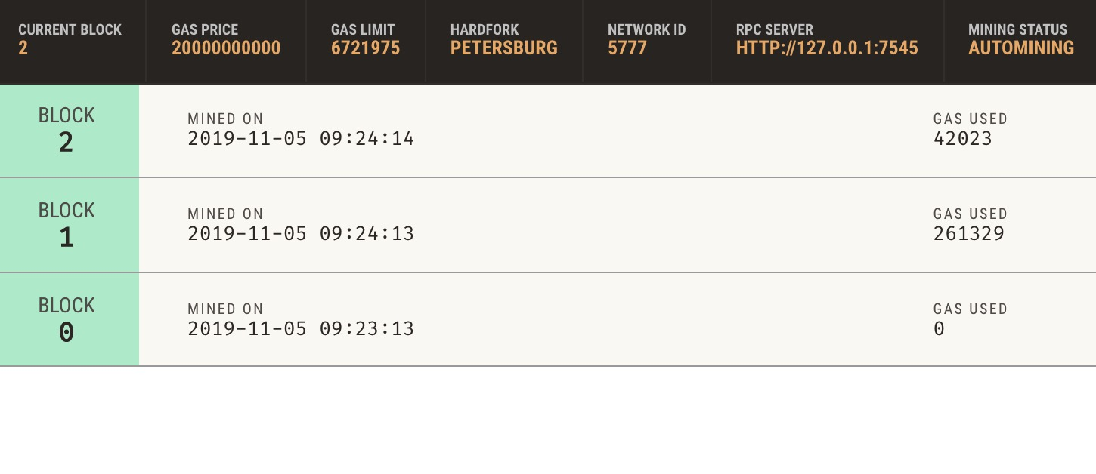
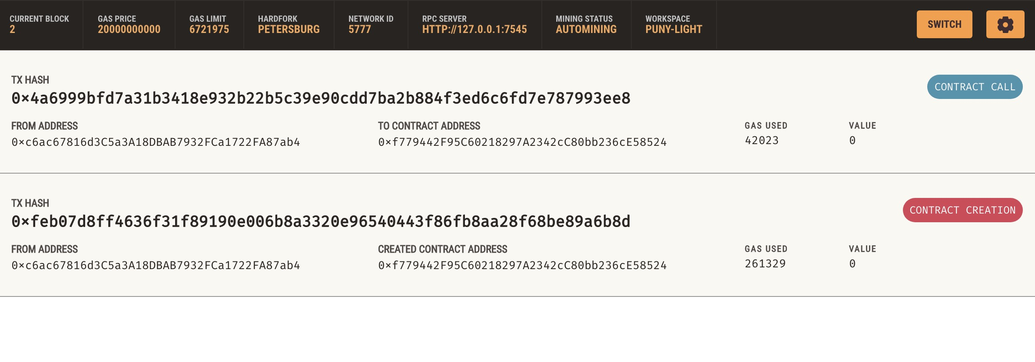
The Truffle workflow – SimpleStorage

Slide 83
The Truffle workflow – SimpleStorage
The migration process is handled by updating state in the migrations.sol.
This is why we see two transactions, one for contract creation and one for updating state.
State is linked to migration scripts in the migrations folder and the migration command processes scripts there in the increasing order.

Slide 84
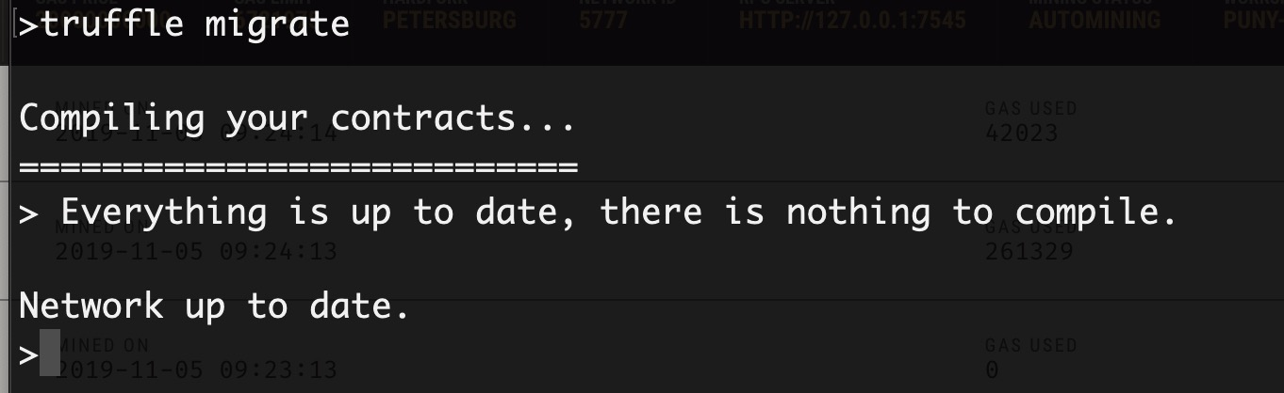
The Truffle workflow – SimpleStorage
If we run the migration script again, it wont do anything.
This is because the state being maintained in the migration.sol is up to date.

Slide 85
The Truffle workflow – SimpleStorage
As per our structure, we only have a single file in the folder, 1_initial_migration.js with following contents
const Migrations = artifacts.require("Migrations");
module.exports = function(deployer) {
deployer.deploy(Migrations);
};

Slide 86
The Truffle workflow – SimpleStorage
No wonder why our migration command didnt deploy the SimpleStorage contract. We didnt ask it to!
Lets add another file in the migrations folder, named 2_simpStor_initial_migration.js, with following contents
const SimpleStorage = artifacts.require("SimpleStorage");
module.exports = function(deployer) {
deployer.deploy(SimpleStorage);
};

Slide 87
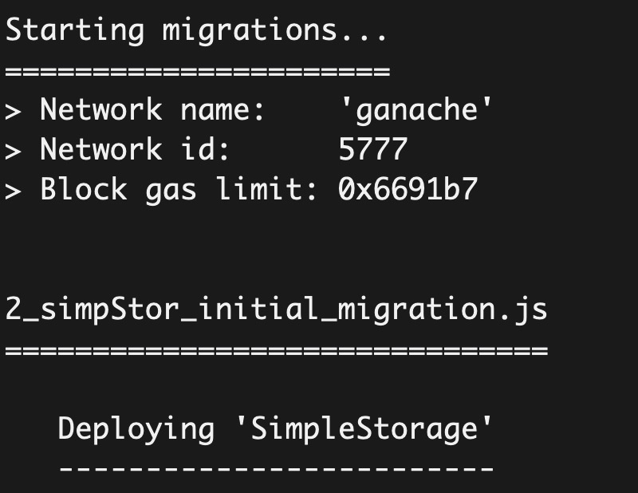
The Truffle workflow – SimpleStorage
Lets truffle migrate again.

Slide 88
The Truffle workflow – SimpleStorage
In Ganache, we can see two new transactions; one for contract creation and one other for?

Slide 89
The Truffle workflow – SimpleStorage
What if we need to change our contract now?
We can change, use a new migration script, 3_.. And then truffle migrate
function set(uint x) public {
storedData = x+1;
}

Slide 90
Interacting with the Contracts
The Ethereum network makes a distinction between writing data to the network and reading data from it. Why?
In general, writing data is called a transaction whereas reading data is called a call.

Slide 91
Contract Interaction - Transactions
Transactions fundamentally change the state of the network.
The defining characteristic of a transaction is that it writes (or changes) data.
Transactions cost Ether to run, known as "gas", and transactions take time to process.

Slide 92
Contract Interaction - Calls
Calls can be used to execute code on the network, though no data will be permanently changed.
Calls are free to run, and their defining characteristic is that they read data.

Slide 93
... back to SimpleStorage
Our contract has two methods.
Set and Get.
Which one requires call and which one requires a transaction?

Slide 94
Setting value at SimpleStorage
Launch Ganache and in use the command truffle console to launch console.
We can then create an instance representing the deployed contract as follows:
>cd ~/ethereum/truffle/
>ls
BlankProject MetaCoin simplestorage
>cd simplestorage/
>truffle console
truffle(ganache)>
let instance = await SimpleStorage.deployed()

Slide 95
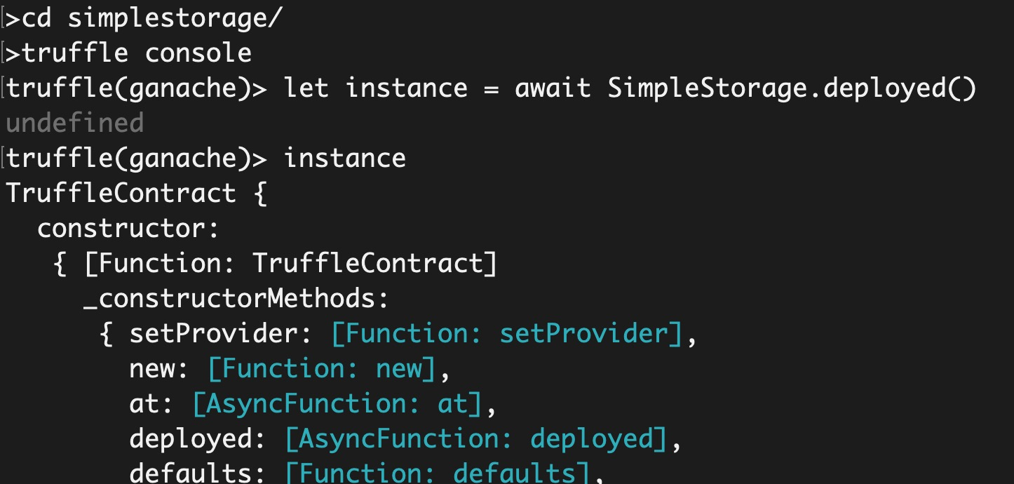
Setting value at SimpleStorage

Slide 96
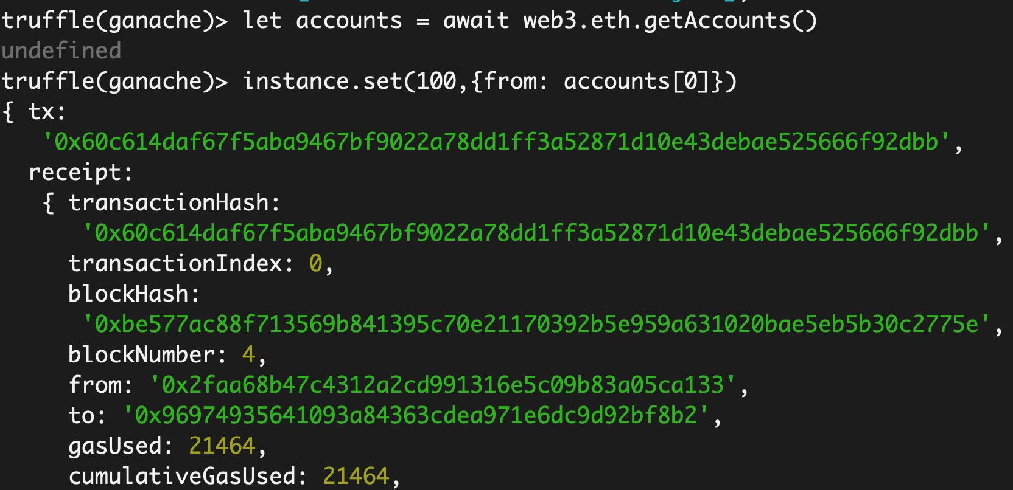
Setting value at SimpleStorage

Slide 97
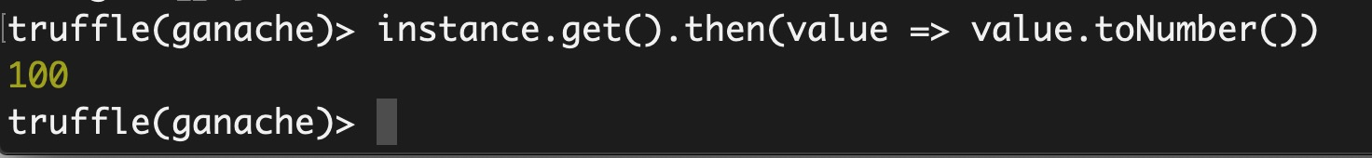
Getting value at SimpleStorage

Slide 98
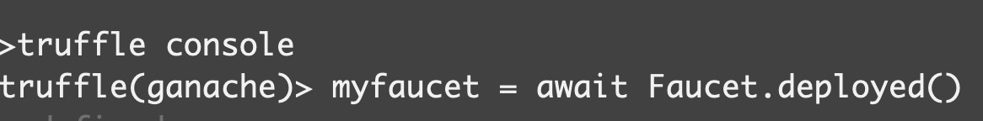
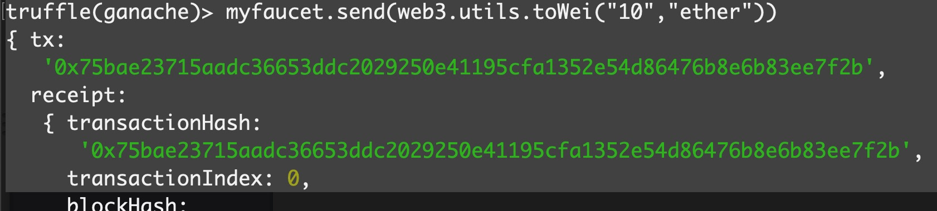
For our Faucet contract

